Slide 1
Solving problems by searching

Slide 2
Problem-solving agent
Goal-based agent
Finds sequences of actions that lead to desirable states
Uninformed search algorithms—algorithms that are given no information about the problem other than its definition. (Blind search)
Informed search algorithms can do quite well given some guidance (Heuristic search)

Slide 3
Problem-solving agent(2)
Intelligent agents are supposed to maximize their performance measure.
Goals help organize behavior by limiting the objectives that the agent is trying to achieve and hence the actions it needs to consider.
Goal formulation is the first step in problem solving.
Problem formulation is the process of deciding what actions and states to consider given a goal.
Assume that the environment is observable, discrete, known and deterministic
Under these assumptions, the solution to any problem is a fixed sequence of actions

Slide 4
Problem-solving agent (3)
The process of looking for a sequence of actions that reaches the goal is called search.
A search algorithm takes a problem as input and returns a solution in the form of an action sequence.
Once a solution is found, the actions it recommends can be carried out. This execution is called the execution phase.
“Formulate, Search, Execute” design for the agent.
After formulating a goal and a problem to solve, the agent calls a search procedure to solve it. It then uses the solution to guide its actions.

Slide 5
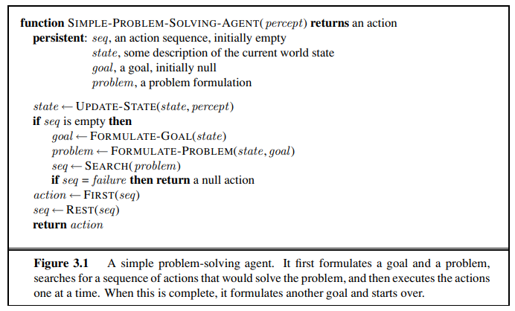

Slide 6
Well-defined problems and solutions
Initial state
Actions
Transition model
Goal test
Path cost

Slide 7
Well-defined problems
A problem can be defined formally by five components:
The initial state that the agent starts in.
Description of the possible actions available to the agent.
Given a particular state s, ACTIONS(s) returns the set of actions that can be executed in s. Description of what each action does (transition model) specified by a function RESULT(s, a) that returns the state that results from doing action a in state s (successor).
The goal test, which determines whether a given state is a goal state.
A path cost function that assigns a numeric cost to each path. The problem-solving agent chooses a cost function that reflects its own performance measure.

Slide 8
Well-defined problems (2)
The step cost of taking action a in state s to reach state s is denoted by
c(s, a, s’ ).
Together the initial state, actions, and transition model implicitly define the state space of the problem—the set of all states reachable from the initial state by any sequence of actions.
The state space forms a directed network or graph in which the nodes are states and the links between nodes are actions.
A path in the state space is a sequence of states connected by a sequence of actions.

Slide 9
Solution
A solution to a problem is an action sequence that leads from the initial state to a goal state.
Solution quality is measured by the path cost function.
Optimal solution has the lowest path cost among all solutions.

Slide 10
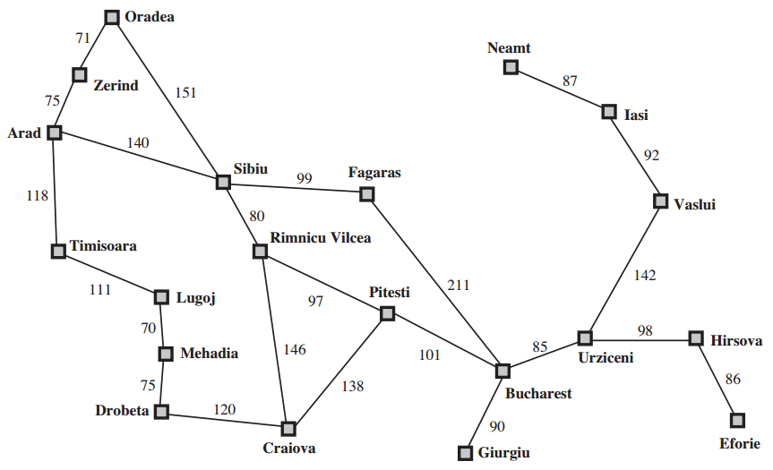
A simplified road map of part of Romania.

Slide 11
Romania
The initial state for agent in Romania might be described as In(Arad). A description of the possible actions available to the agent. Given a particular state s, ACTIONS(s) returns the set of actions that can be executed in s. the applicable actions are {Go(Sibiu), Go(Timisoara), Go(Zerind)}. •
the transition model, specified by a function RESULT(s, a) that returns the state that results from doing action a in state s. RESULT(In(Arad),Go(Zerind)) = In(Zerind) .
.The agent’s goal in Romania is the singleton set {In(Bucharest)}.
For the agent trying to get to Bucharest, time is of the essence, so the cost of a path might be its length in kilometers.

Slide 12
Formulating problems
The process of removing detail from a representation is called abstraction.
In addition to abstracting the state description, we must abstract the actions themselves.
This abstract solution corresponds to a large number of more detailed paths.

Slide 13
Toy problems vs Real-world problem
A toy problem is intended to illustrate or exercise various problem-solving methods. It can be given a concise, exact description and hence is usable by different researchers to compare the performance of algorithms.
A real-world problem is one whose solutions people actually care about. Such problems tend not to have a single agreed-upon description, but we can give the general flavor of their formulations.

Slide 14
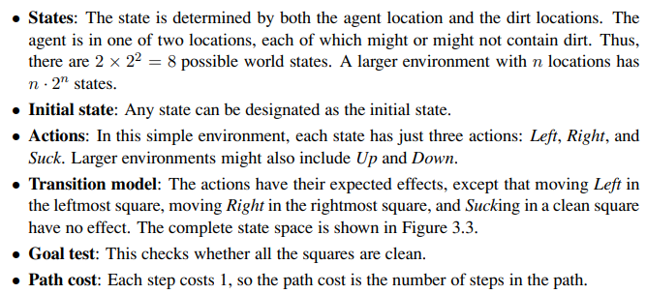
Toy problem -- Vacuum world

Slide 15
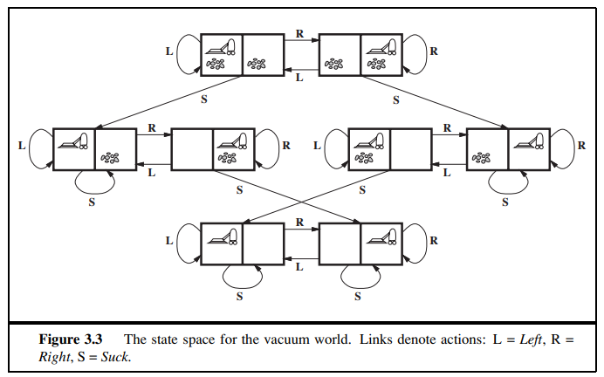
Vacuum world

Slide 16
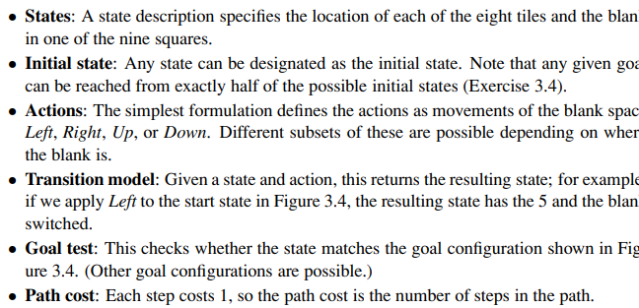
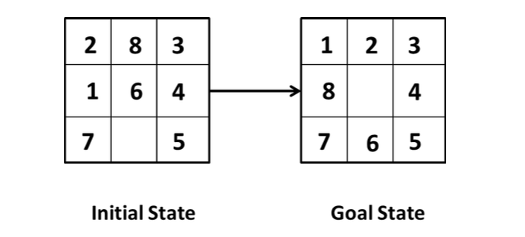
8-puzzle

Slide 17
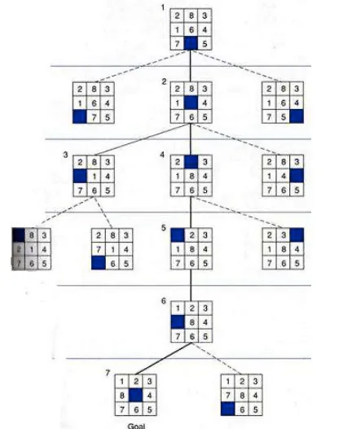

Slide 18
Possible states
8-puzzle has a property that exactly half (of all) permutations can be reached from any starting state. 9! is the total number of possible configurations of the puzzle, whereas 9!/2 is the total number of solvable configurations.
If you draw a graph of every single state with every single possible transition out of that state you will end up with 9! / 2 states with 9! transitions. There are states that exist but don't fall on the graph and those are the "unsolvable" ones.

Slide 19
8-Queens problem
Given an 8x8 chess board, you must place 8 queens on the board.
A queen can move vertically, horizontally and diagonally in any number of steps
8 x 8 chessboard that no queens attack each other by being in the same row, column or diagonal.

Slide 20
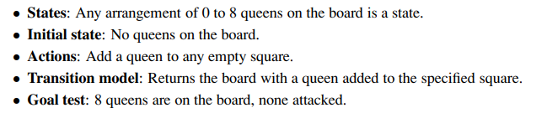
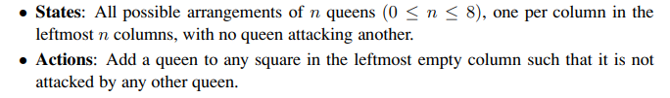
8-queens problem

Slide 21
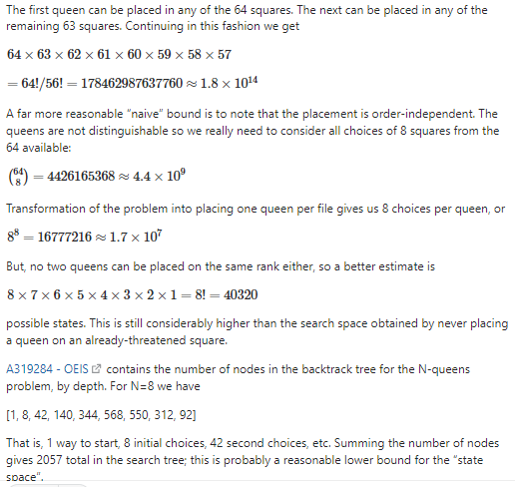

Slide 22
Real-world problem: Route-finding problem
Route-finding algorithms are used in a variety of applications.
Web sites and in-car systems that provide driving directions, are relatively straightforward extensions of the Romania example.
Others, such as routing video streams in computer networks, military operations planning, and airline travel-planning systems, involve much more complex specifications.

Slide 23
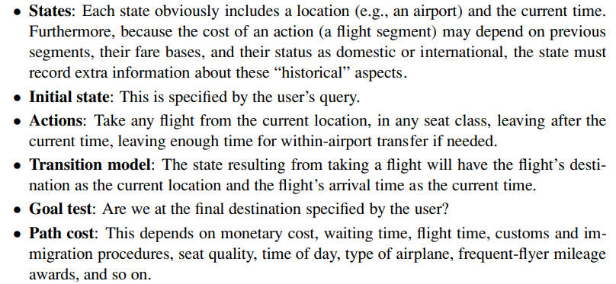
Airline travel problem

Slide 24
Other Problems
The traveling salesperson problem (TSP) is a touring problem in which each city must be visited exactly once. The aim is to find the shortest tour.
A VLSI layout problem requires positioning millions of components and connections on a chip to minimize area, minimize circuit delays, minimize stray capacitances, and maximize manufacturing yield.
Robot navigation is a generalization of the route-finding problem

Slide 25
Robot navigation
Rather than following a discrete set of routes, a robot can move in a continuous space with (in principle) an infinite set of possible actions and states.
For a circular robot moving on a flat surface, the space is essentially two-dimensional.
When the robot has arms and legs or wheels that must also be controlled, the search space becomes many-dimensional.
Advanced techniques are required just to make the search space finite.

Slide 26
Water jug problem
Given a 4-gallons jug and a 3 gallon jug, measure exactly 2 gallons into one bucket. There are no markings on the jugs. Jugs must be filled completely.

Slide 27
Water jug problem(2)
Initial state: Jugs are empty - (0,0)
Goal state : One of the jugs has 2 gallons of water
(x,2) or (2,y)
Actions:
Filling jug, emptying jug, pumping water from one jug to another jug
Transition model:
Filling a jug Fill(0,y) -> (4,y), Fill(x,0) ->(x,3)
Emptying a jug: Empty(x, y)-> (0,y), Empty(x, y) -> (x,0)
Pumping water:
Path cost: 1 per unit step

Slide 28
Searching for solutions
After formulation, we now need to solve them
A solution is an action sequence, so search algorithms work by considering various possible action sequences
The possible action sequences starting at the initial state form a search tree with the initial state at the root.
The branches are actions and the nodes correspond to states in the state space of the problem.
Starting from initial state, expand the current state; that is, apply each legal action to the current state, thereby generating a new set of states.
The set of all leaf nodes available for expansion at any given point is called the frontier ( also known as open list).
The process of expanding nodes on the frontier continues until either a solution is found or there are no more states to expand.

Slide 29
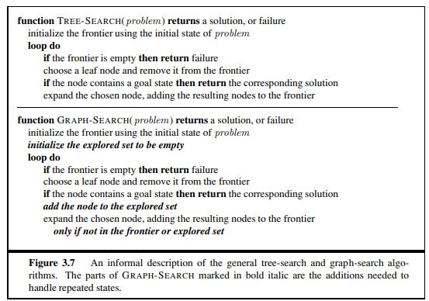
Search algorithms

Slide 30
Search algorithms all share this basic structure; they vary primarily according to how they choose which state to expand next—the so-called search strategy.
Repeated state in the search tree generates a loopy path.
loops can cause algorithms to fail, making otherwise solvable problems unsolvable.
Fortunately, there is no need to consider loopy paths.
Path costs are additive and step costs are nonnegative
A loopy path to any given state is never better than the same path with the loop removed.

Slide 31
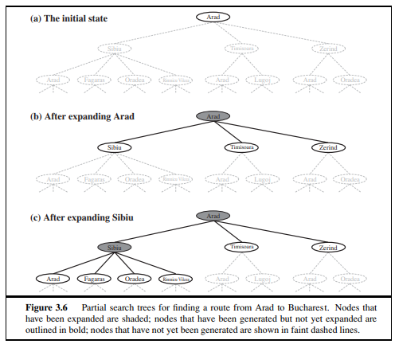

Slide 32
Algorithms that forget their history are doomed to repeat it.
The way to avoid exploring redundant paths is to remember where one has been.
To do this, augment the TREE-SEARCH algorithm with a data structure called the explored set (also known as the closed list), which remembers every expanded node.
Newly generated nodes that match previously generated nodes—ones in the explored set or the frontier—can be discarded instead of being added to the frontier.

Slide 33
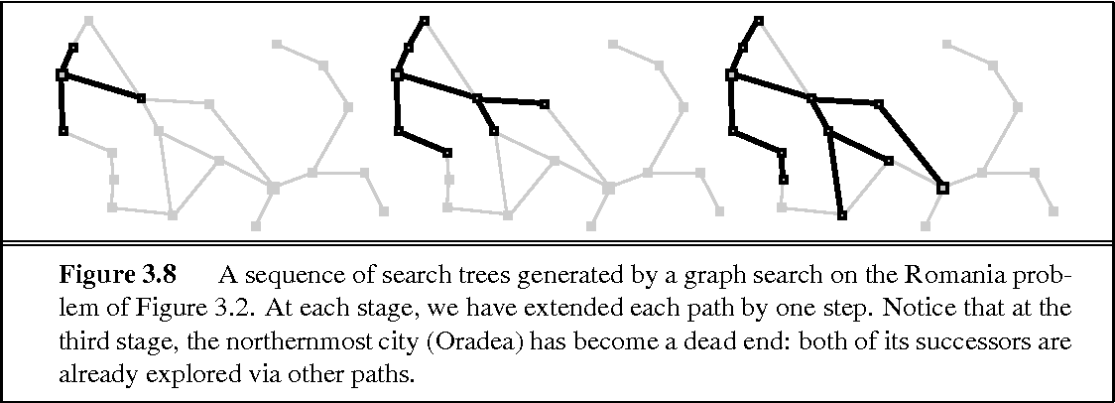
Clearly, the search tree constructed by the GRAPH-SEARCH algorithm contains at most one copy of each state,
The algorithm has another nice property: the frontier separates the state-space graph into the explored region and the unexplored region, so that every path from the initial state to an unexplored state has to pass through a state in the frontier

Slide 34
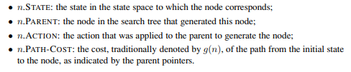
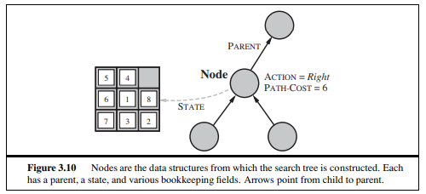
Infrastructure for search algorithms
. For each node n of the tree, has a structure that contains four components:

